Slide 1

KAKATIYA INSTITUTE OF TECHNOLOGY & SCIENCE FOR WOMEN
MAJOR PROJECT ON
CLOUD RESOURCE SHARING USING MULTI FACTOR AUTHENCATED KEY EXCHANGE
Presented By :
K.Harichandana -196B1A0543
D.Sreeja -196B1A0524
M.Komali-196B1A0546
N.Ravali-196B1A0557

Slide 2
AGENDA :
SOFTWARE REQUIREMENTS
HARDWARE REQUIREMENTS
MODULES
UML DIAGRAM
SCREEN SHOTS
CONCLUSION
ABSTRACT
INTRODUCTION
EXISTING SYSTEM
DISADVANTAGES
PROPOSED SYSTEM
ADVANTAGES

Slide 3
ABSTRACT :

Slide 4
INTRODUCTON :

Slide 5
Crawler:- Crawlers help in collecting data and information and store it in database .
Indexer:-Indexer arranges each term on each document and stores the subsequent list of terms.
Query Engine It is mainly used to reply to the user’s keyword and show the effective outcome for their keyword. In the query engine, the Page ranking algorithm ranks the document

Slide 6
EXISTING SYSTEM :
IR is built by using SVM and XGBoost algorithms.
SVM is used to classify the data for the accuracy.
XGBoost algorithm is used to calculate weight and rank.
IR may deal with the organization, storage, retrieval and evaluation of information from documents, particularly textual information. But we cannot give the ranks to those documents.

Slide 7
DISADVANTAGES :
IR will be very difficult if large numbers of texts in a document.
Difficult to identify the important concepts or topic in a collection of documents.
Search by rank is not possible.

Slide 8
PROPOSED SYSTEM :
The proposed information retrieval system is very useful for finding out more relevant files for given keywords.
Anyone can easily identify the important documents in a collection of documents and retrieve the related data.
Proposed system consist of PAC algorithm and NLP techniques.
Where PAC algorithm is used to produce maximum accuracy and NLP is used to process the given text.

Slide 9
ADVANTAGES :
IR system gives the file of the most relevant files at the top of the search result based on the keyword , according to user queries.
Search by rank is possible.
The main focus of our system is to build a own search engine to discover the utmost suitable file for the given keyword by using machine learning techniques for increasing accuracy compared to available system.

Slide 10
SOFTWARE REQUIREMENTS :
OPERATING SYSTEM : Windows 10
CODING LANGUAGE : Python
FRONT END : Python
DESIGNING : Html , CSS , Java script
DATABASE : MySQL

Slide 11
HARDWARE REQUIREMENTS :
SYSTEM : Pentium IV 2.4 GHz
HARDDISK : 40 GB
FLOPPY DRIVE : 1.44 Mb
MONITOR : 14’Color Monitor
RAM : 512 Mb

Slide 12
MODULES :
MANAGER : Uploads the file.
USER : Access the file.
ADMIN : Give authority to managers and users .
MACHINE LEARNING : Makes decisions by analyzing existing data.

Slide 13
UML DIAGRAMS :
Use case Diagram
Class Diagram
Sequence Diagram
Activity Diagram

Slide 14
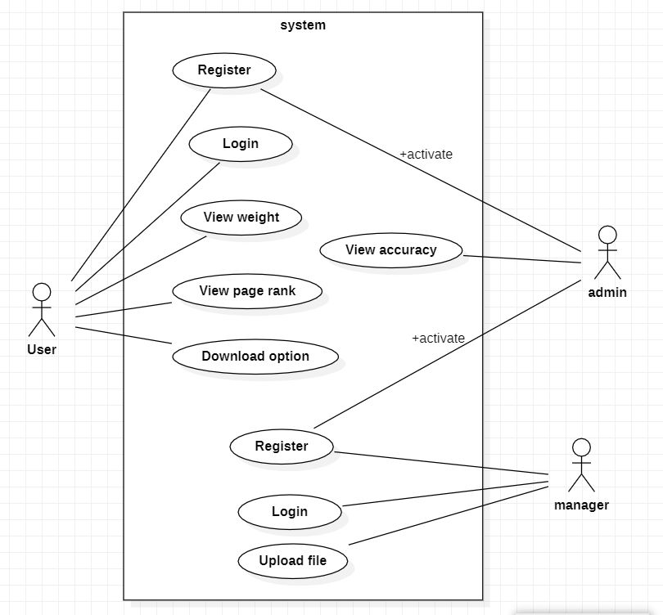
USECASE DIAGRAM :

Slide 15
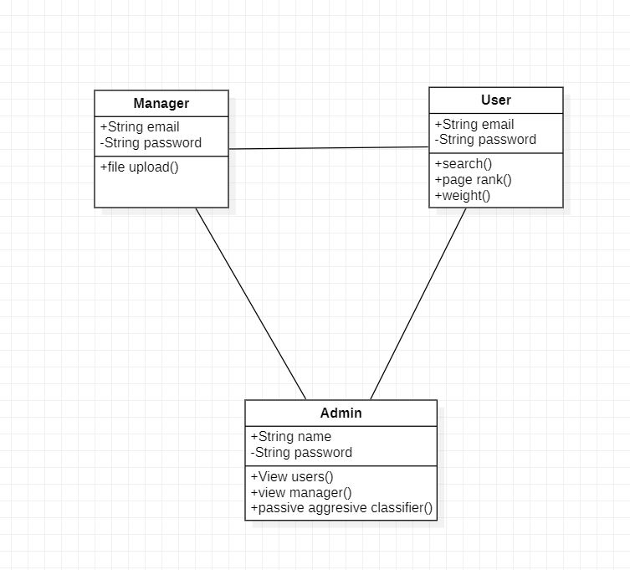
CLASS DIAGRAM :

Slide 16
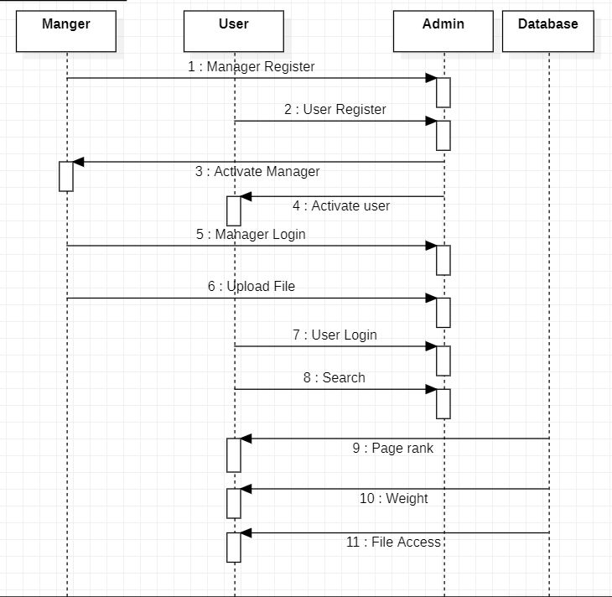
SEQUENCE DIAGRAM :

Slide 17
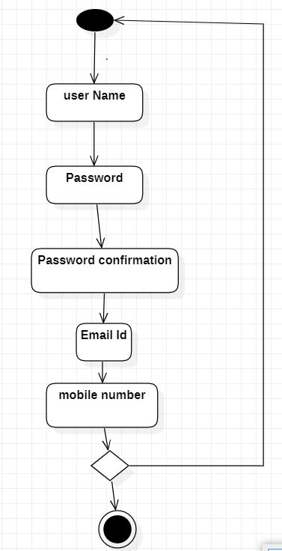
ACTIVITY DIAGRAM :
Activity diagram for registration :

Slide 18
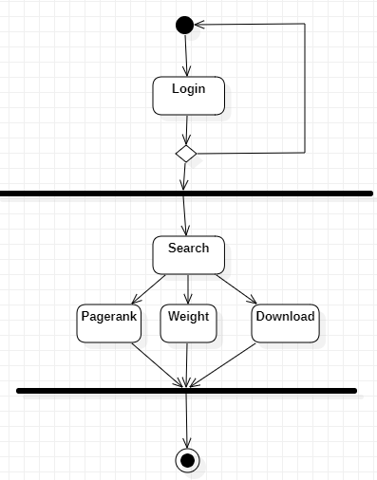
ACTIVITY DIAGRAM :
Activity diagram for User :

Slide 19
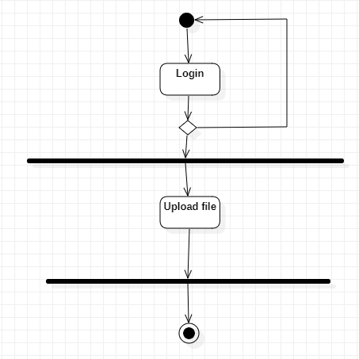
ACTIVITY DIAGRAM :
Activity diagram for manager :

Slide 20
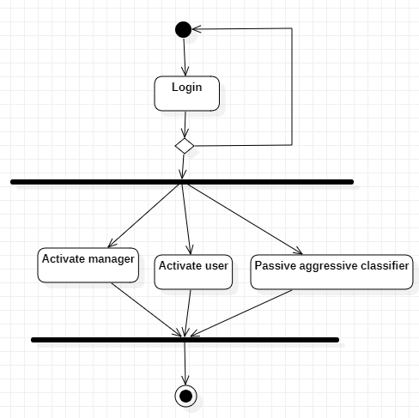
ACTIVITY DIAGRAM :
Activity diagram for Admin :

Slide 21
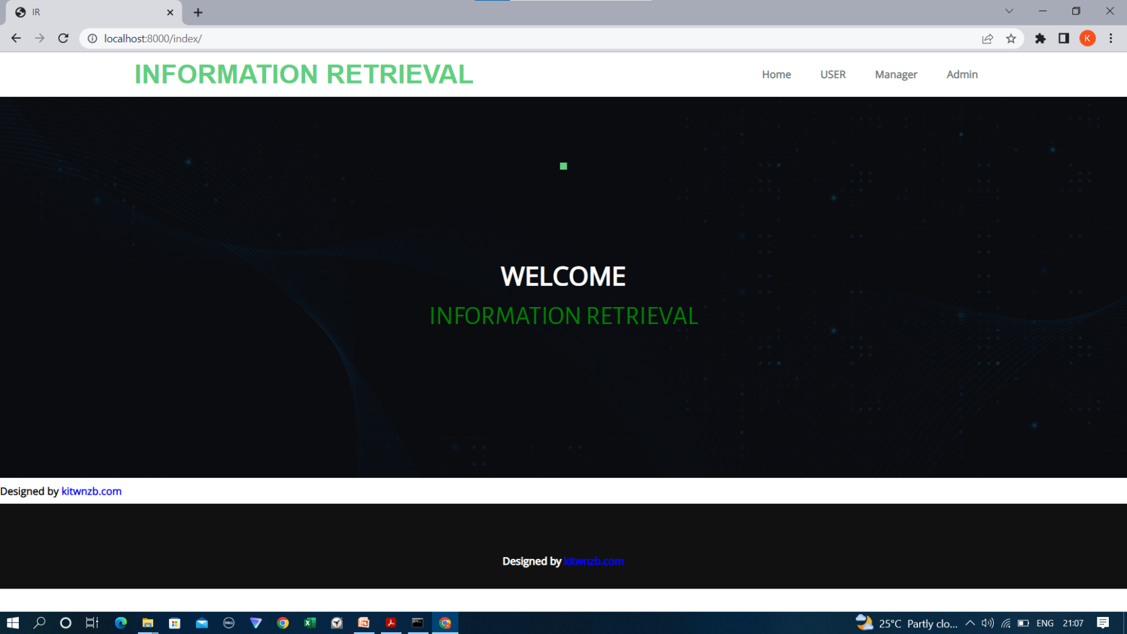
SCREENSHOTS :
Home page :

Slide 22
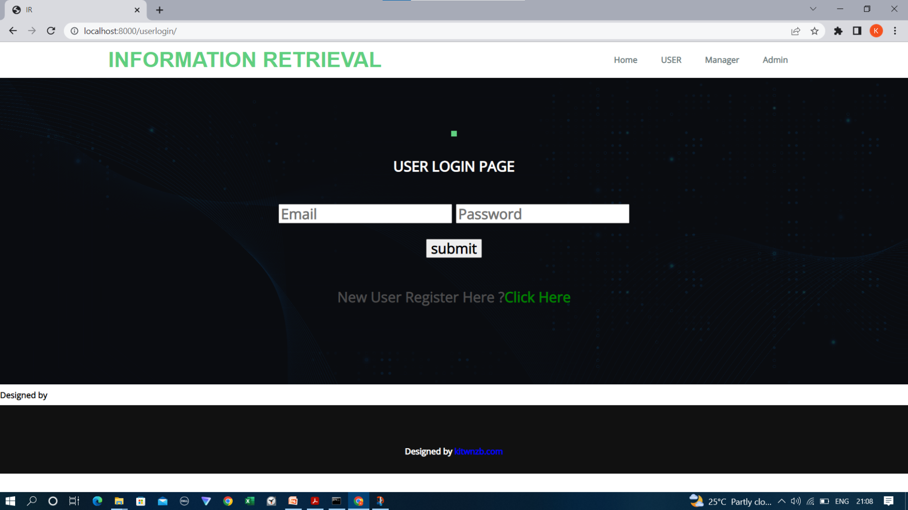
User login page :

Slide 23
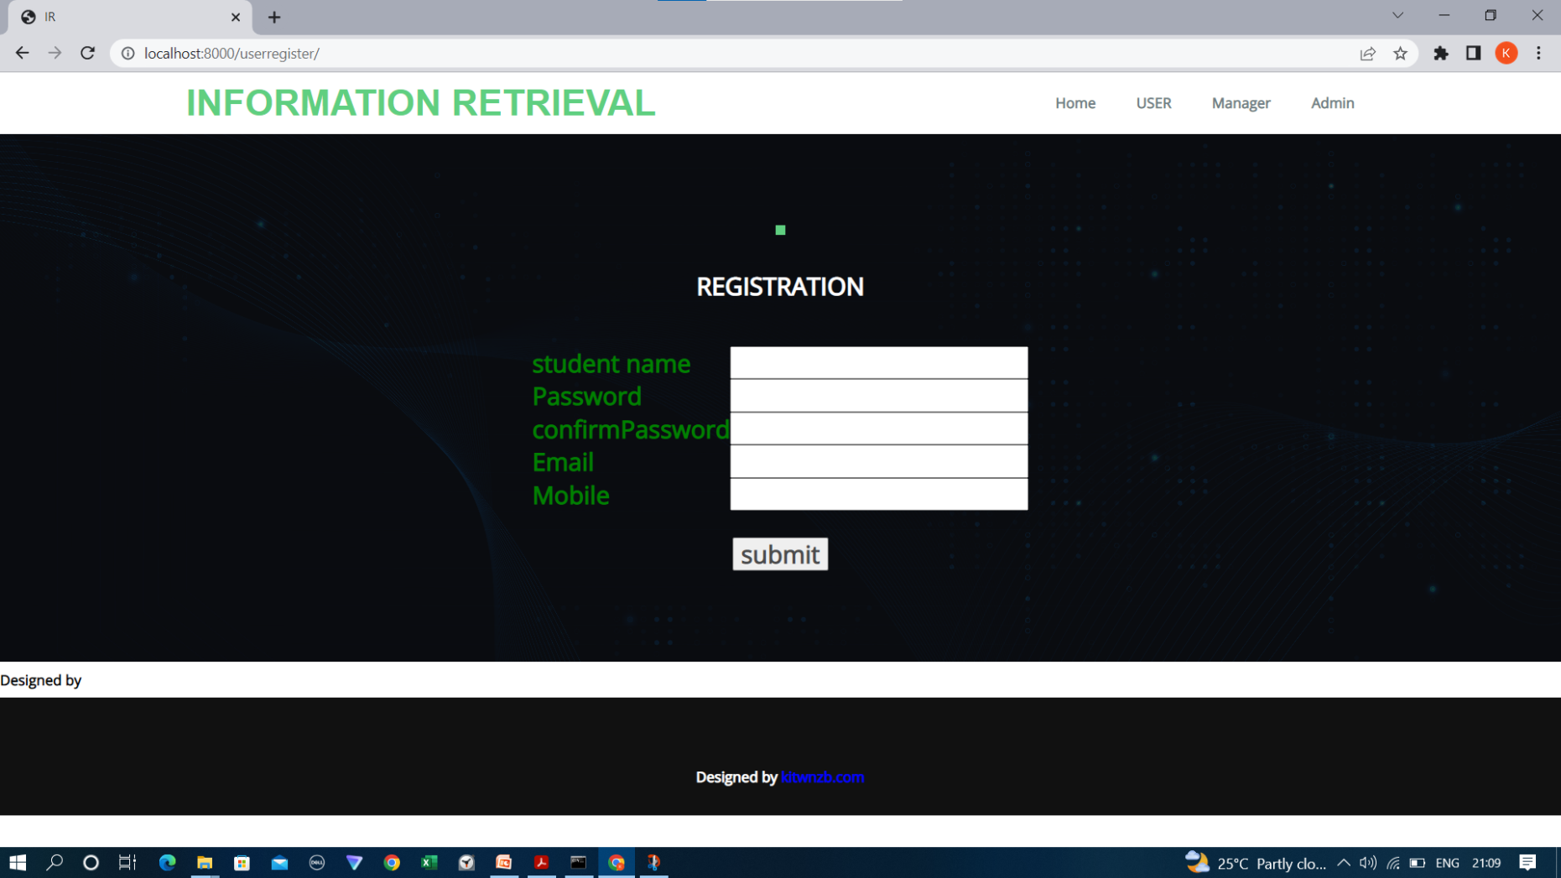
User Registration page :

Slide 24
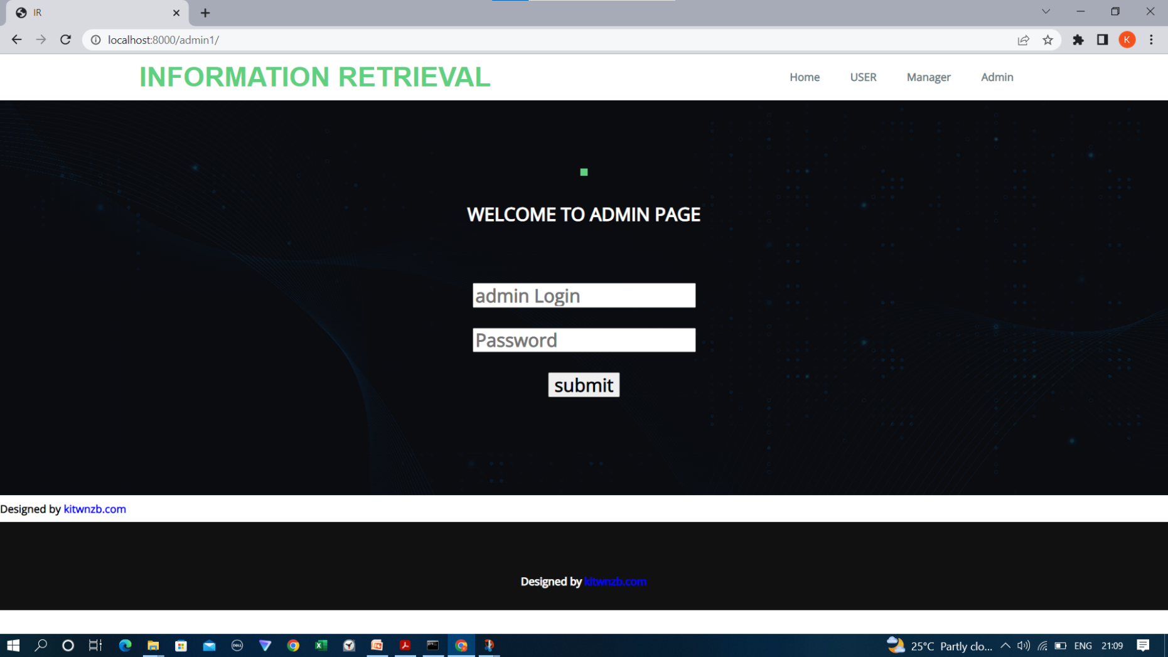
Admin Login page :

Slide 25
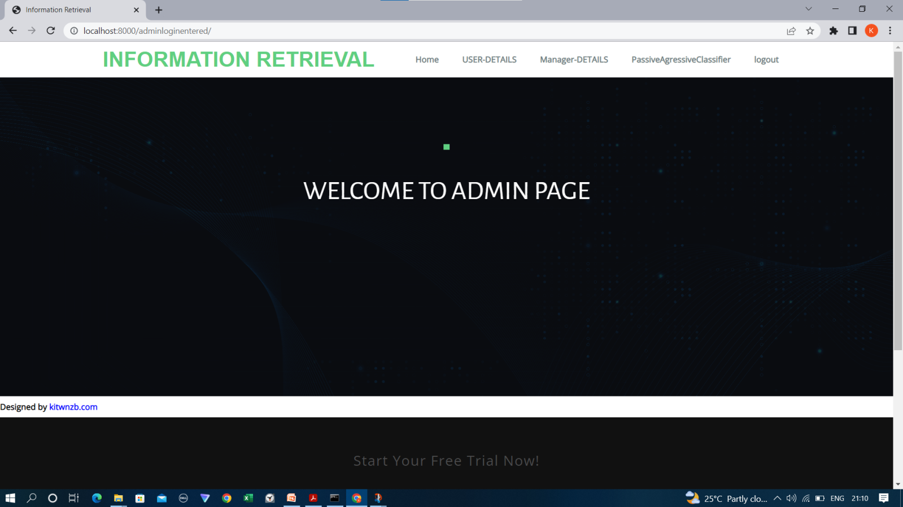
Admin home page :

Slide 26
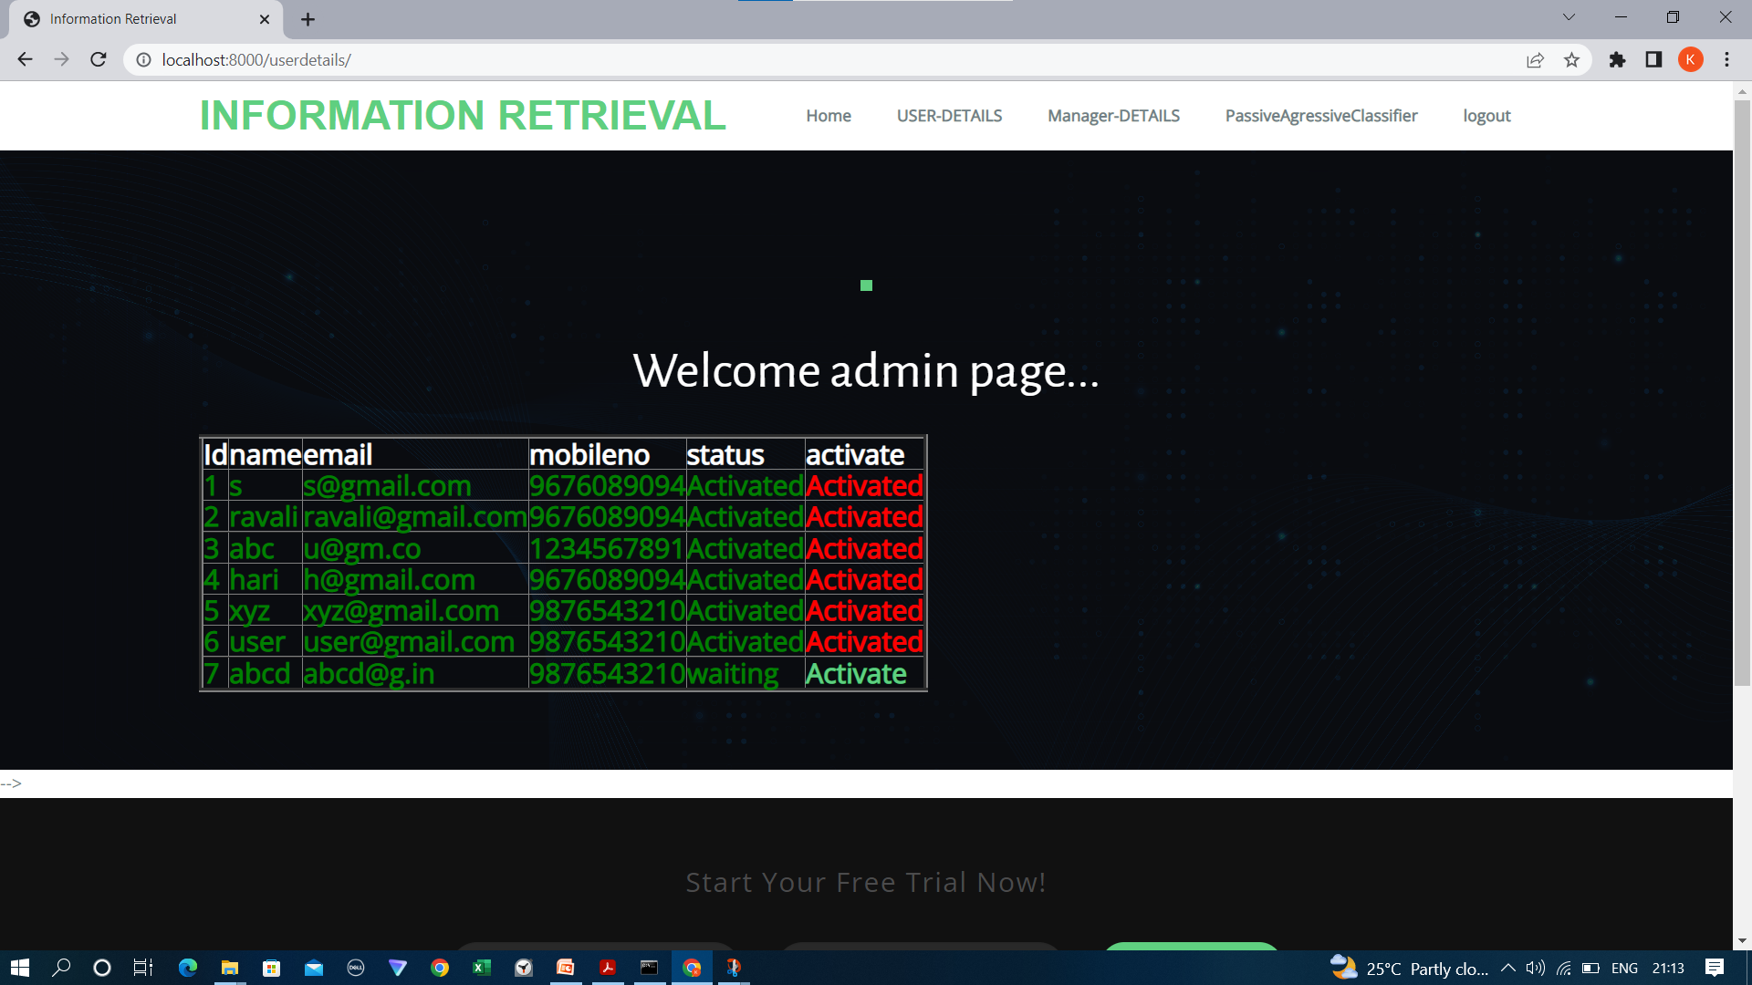
Admin accessing user details :

Slide 27
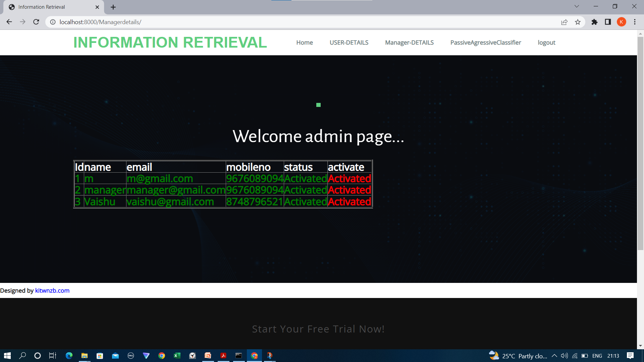
Admin accessing manager details :

Slide 28
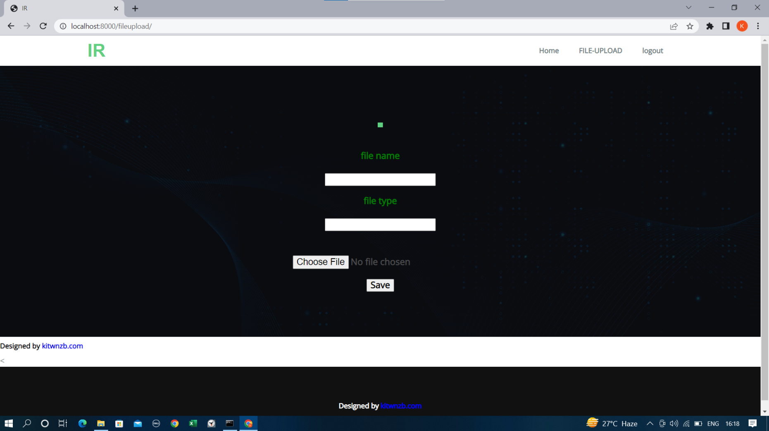
Manager file upload page :

Slide 29
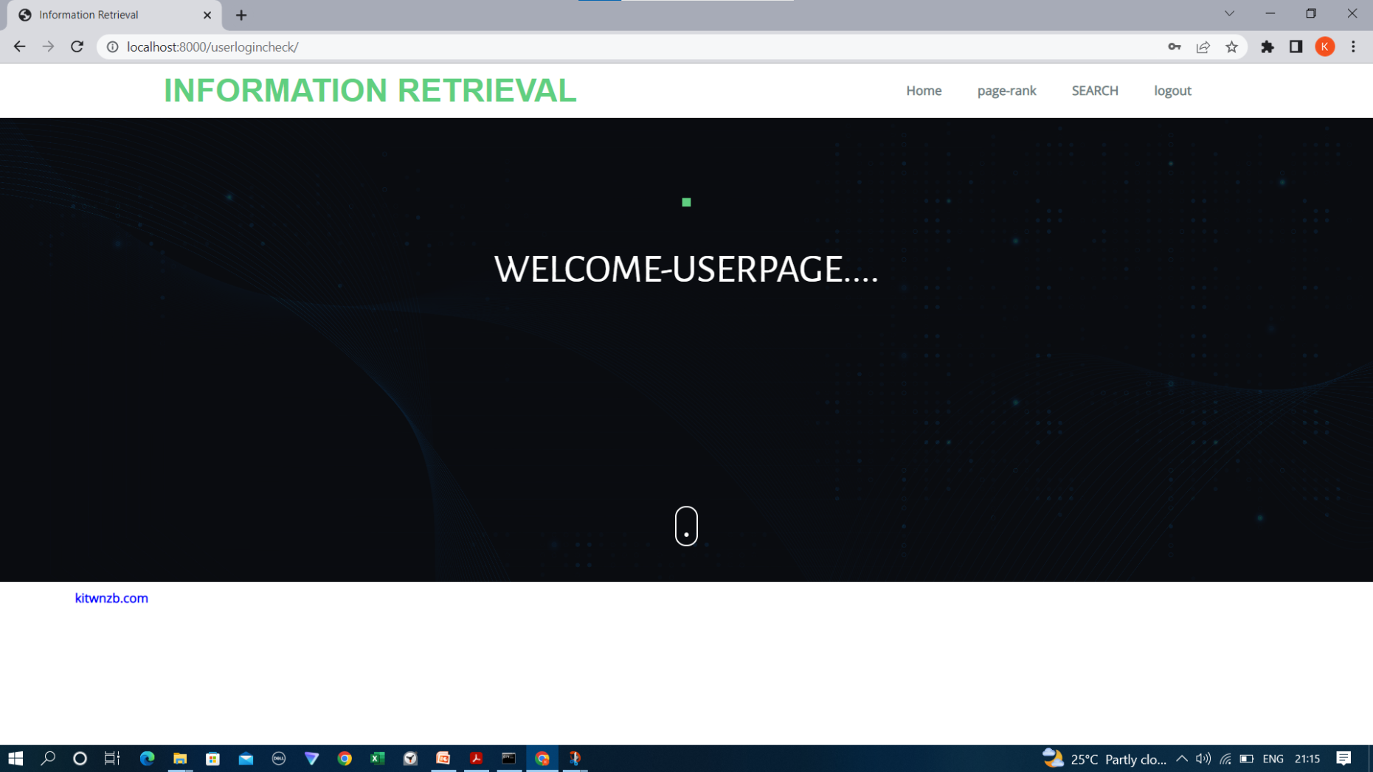
User home page :

Slide 30
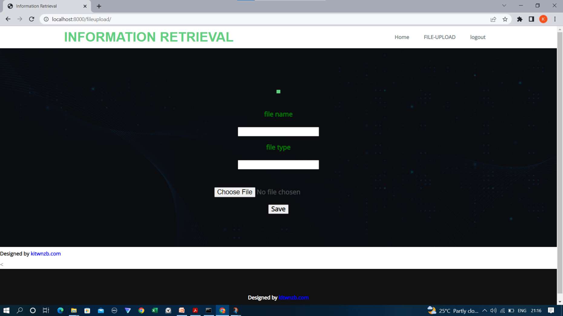
Manager file upload page :

Slide 31
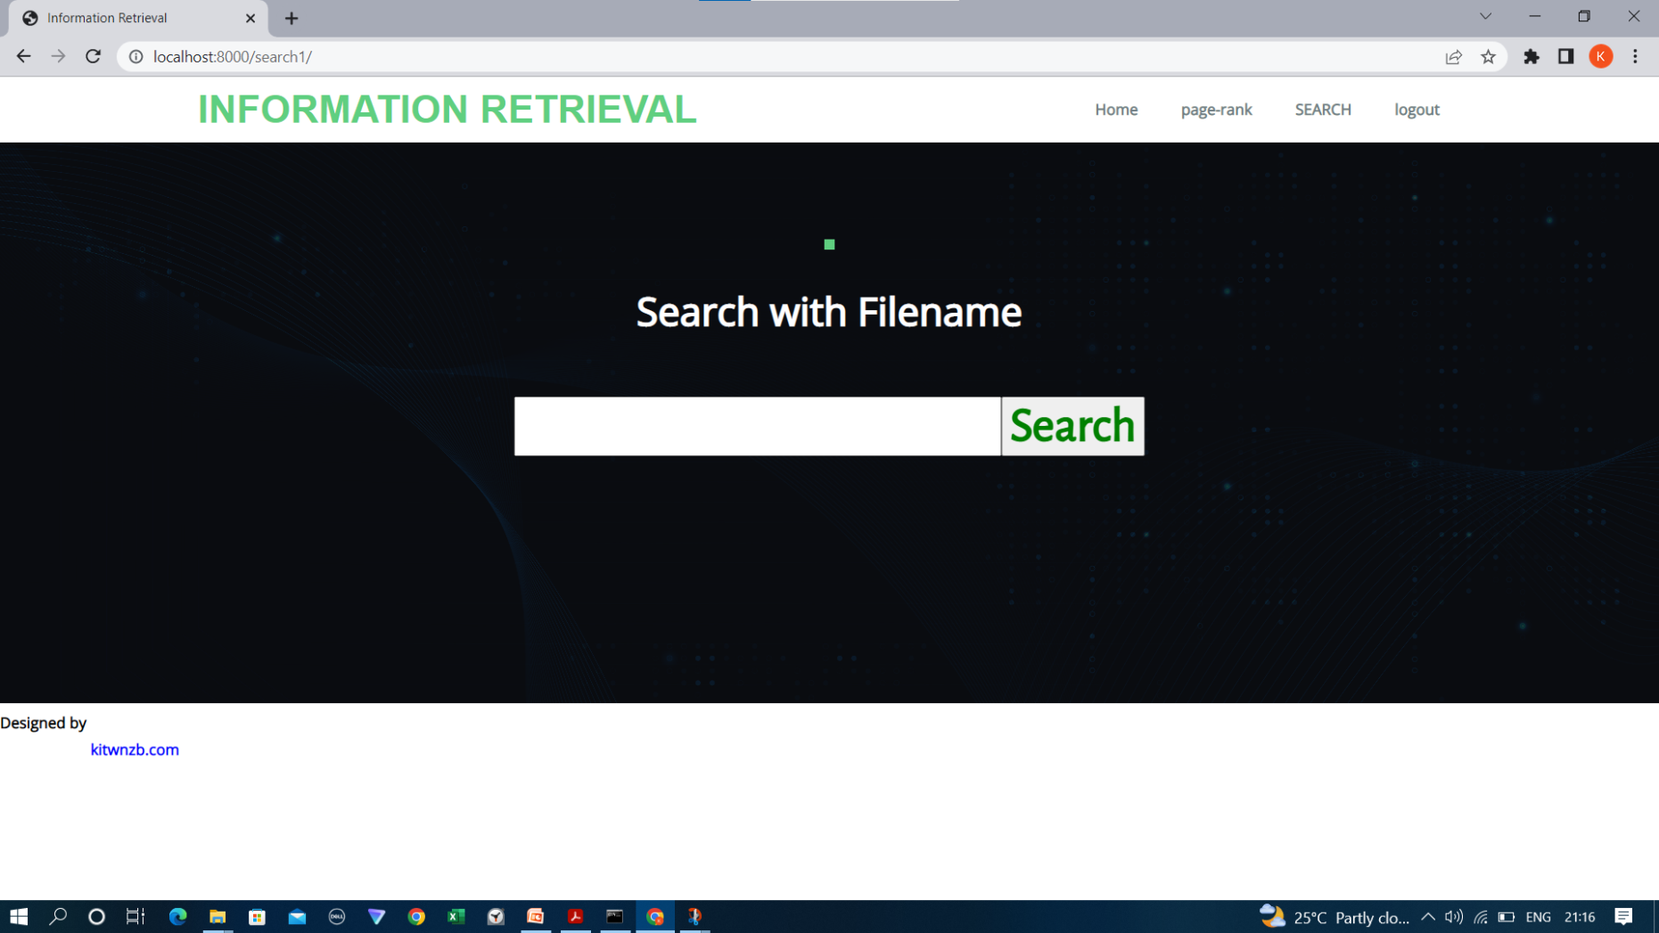
User can search by file name :

Slide 32
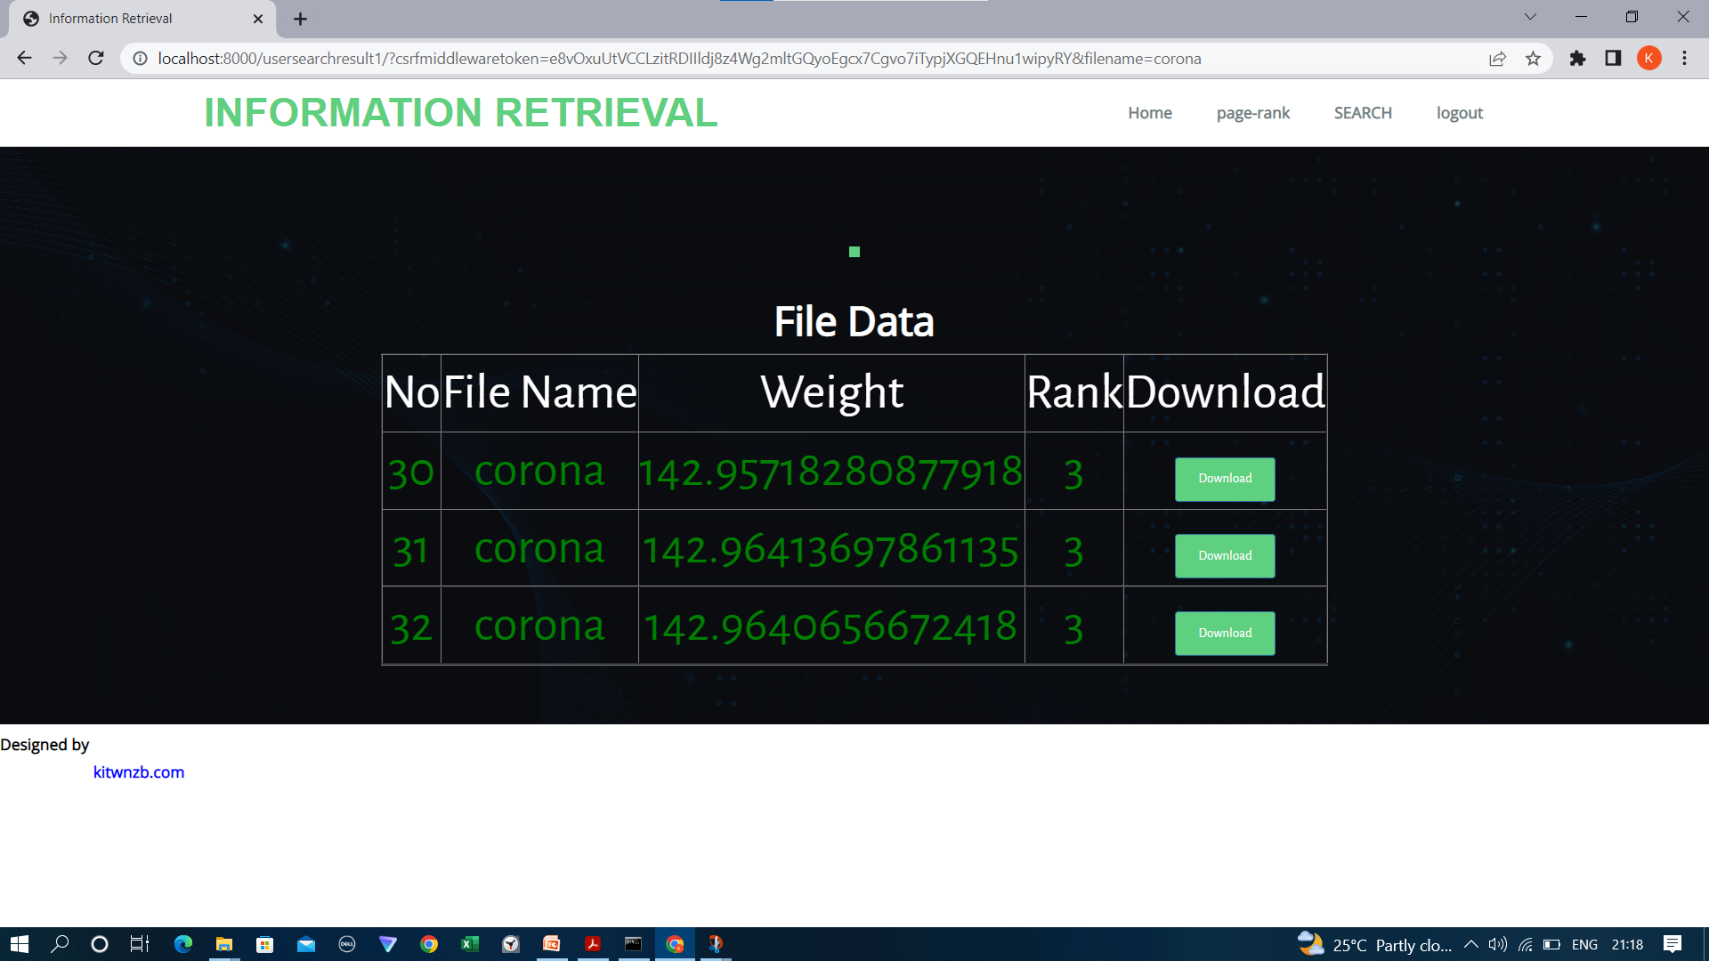
User Search Result :

Slide 33

User can search by pagerank :

Slide 34
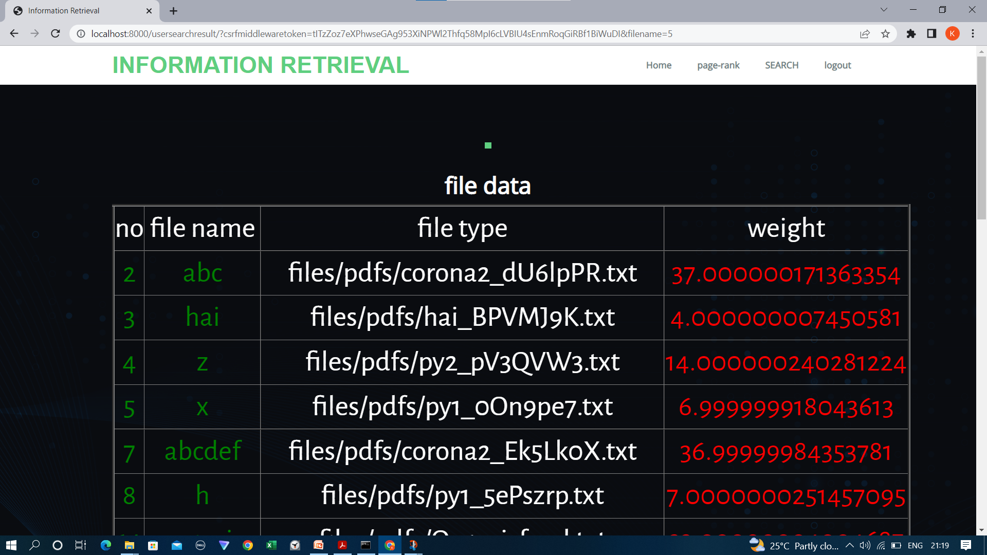
Page by rank result :

Slide 35
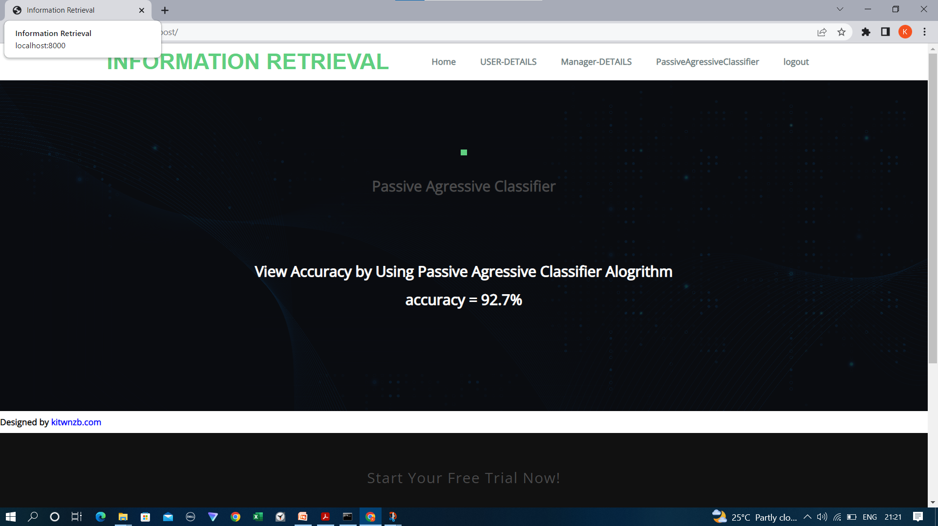
Accuracy :

Slide 36
CONCLUSION :
Information Retrieval is very useful for finding out more relevant files for given keywords.
User time is reduced for searching the relevant files from folders.
For this, Accuracy is a very important factor.
Passive aggressive Classifier will give better accuracy than SVM .

Slide 37
THANK YOU
THANK YOU

